Slide 1
SKIN CANCER IMAGE CLASSIFICATION
WITH CONVOLUTIONAL NEURAL NETWORKS

Slide 2
Problem Statement
Considering the limited availability of the resources, early detection of skin cancer is highly important.
Accurate diagnosis and feasibility of detection are vital in general for skin cancer prevention policy.
Skin cancer detection in early phases is a challenge for even the dermatologist.

Slide 3
Objective
To detect 7 different classes of skin cancer using Convolution Neural Network with keras tensorflow in backend.
To analyse the result to see how the model can be useful in practical scenario.
Diagnosing methodology using Image Processing and Deep Learning models.

Slide 4
Data Description
The dataset that we are using is the HAM10000 dataset.
10015 dermatoscopic images.
7 features - lesion id, image id, dx, dx_type, age, sex, localization
It has 7 different classes of skin cancer:
Melanocytic nevi
Melanoma
Benign keratosis
Basal cell carcinoma
Actinic keratoses
Vascular lesions
Dermatofibroma

Slide 5
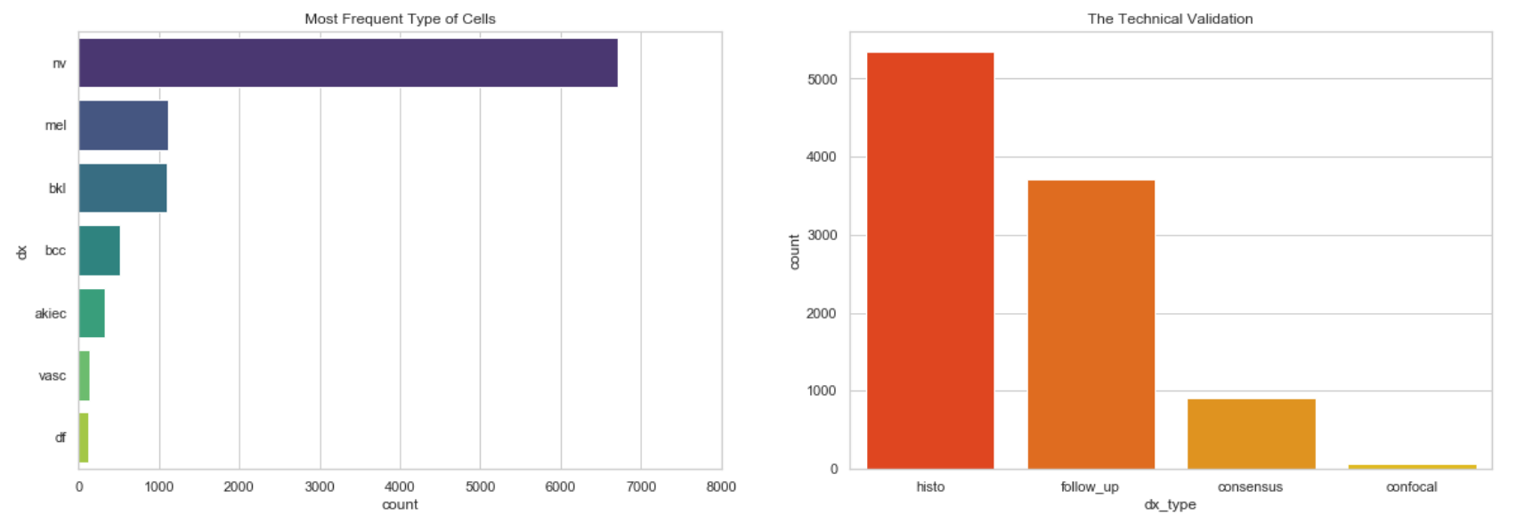
Exploratory Data Analysis - Type of Skin Cancer and Technical Validation

Slide 6
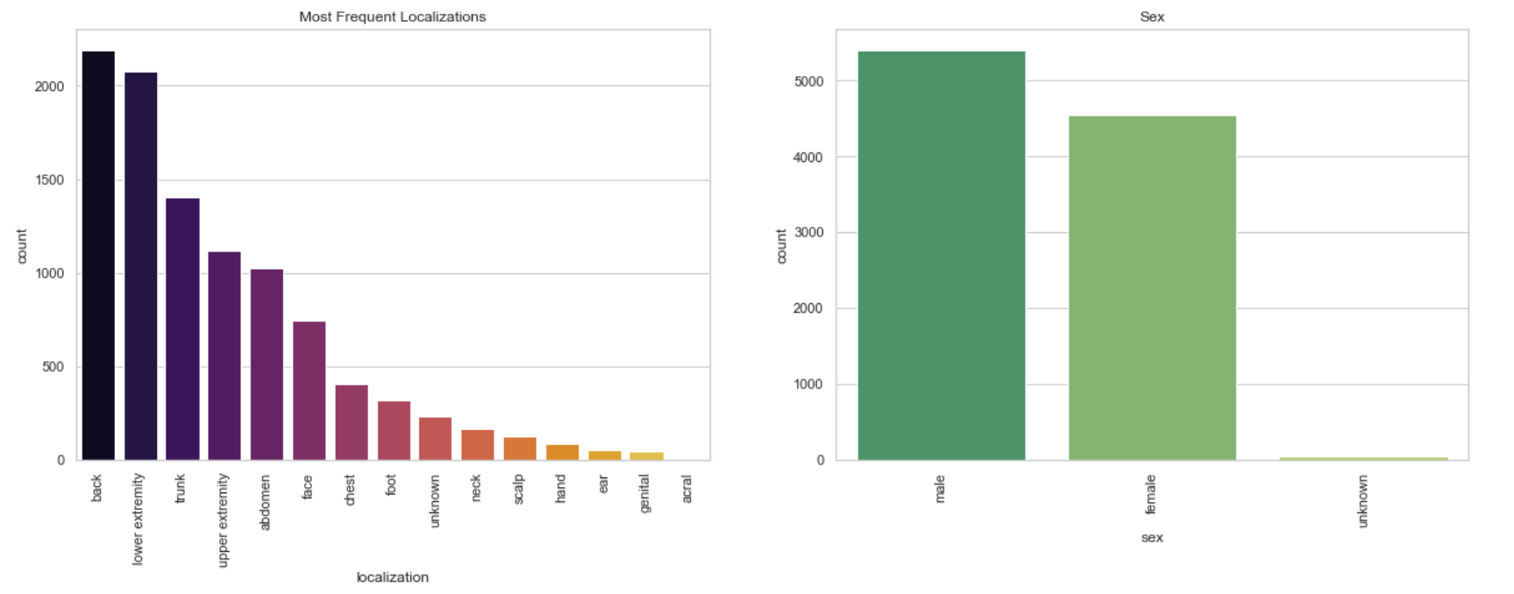
Exploratory Data Analysis - Localization and Sex

Slide 7
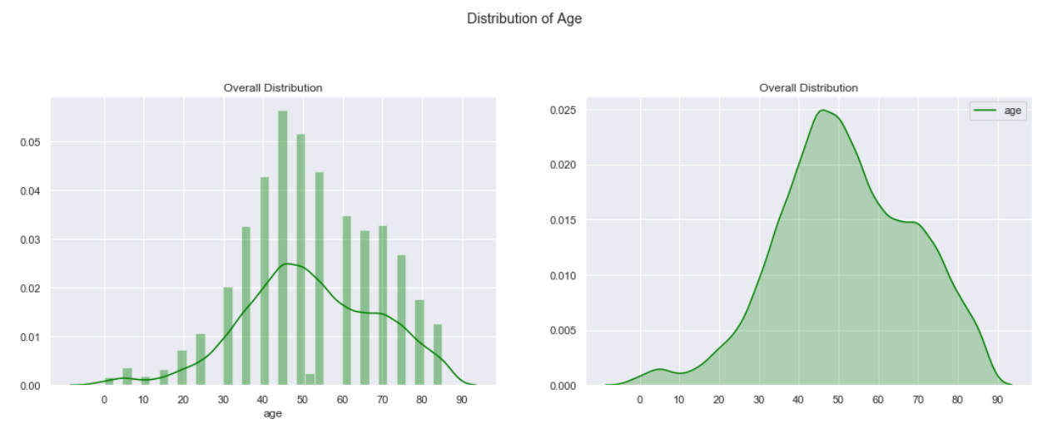
Exploratory Data Analysis - Age

Slide 8
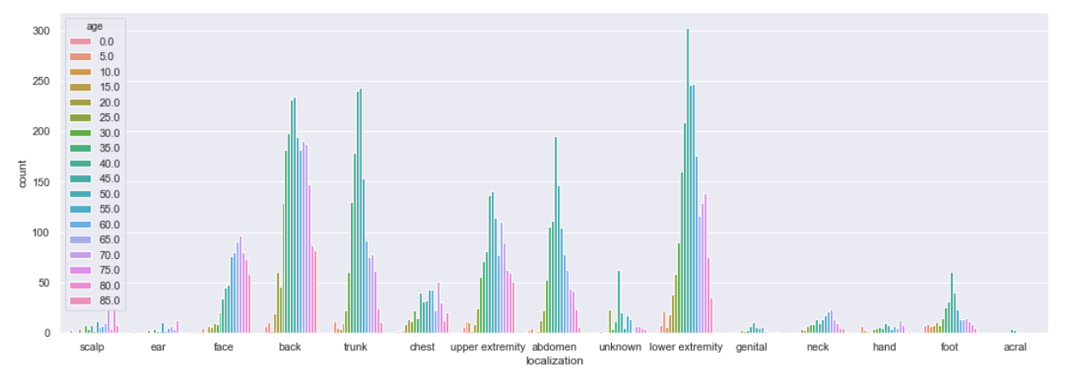
Exploratory Data Analysis - Correlation between Localization and Age

Slide 9
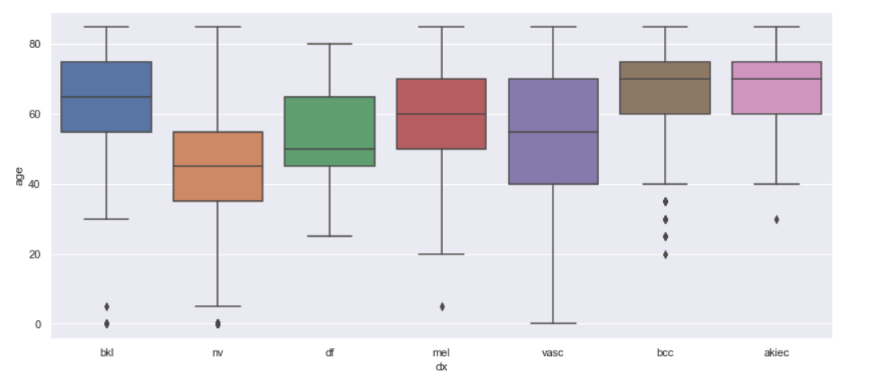
Exploratory Data Analysis - Correlation between Age and Type of Cancer

Slide 10
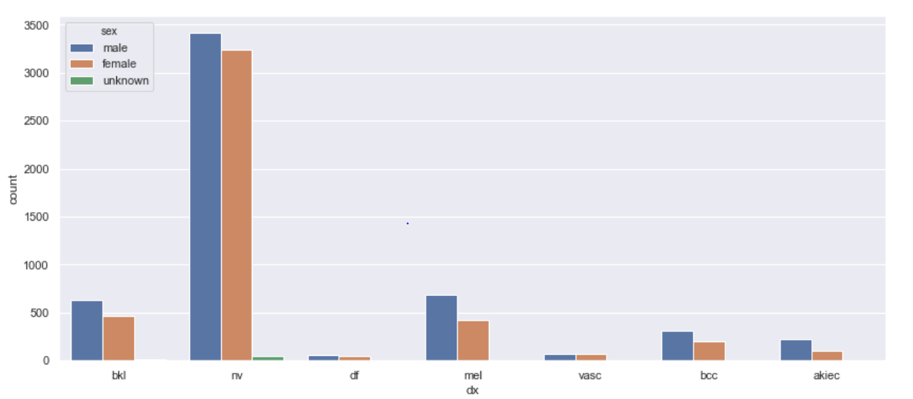
Exploratory Data Analysis - Correlation between Type of Cancer and Sex

Slide 11
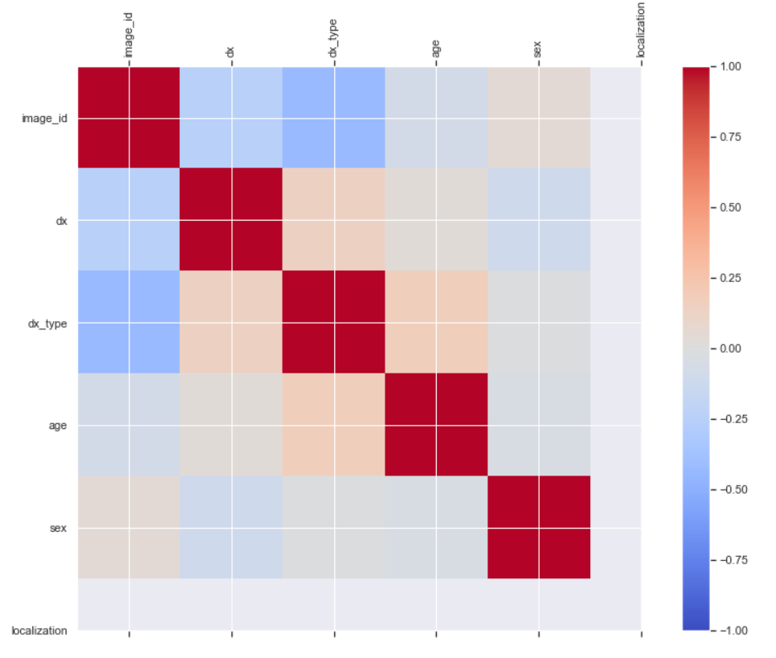
Exploratory Data Analysis - Correlation between parameters

Slide 12
Data Preprocessing
Remove the Null Values
Remove the Duplicates
Splitting the dataset into Training and Testing sets
Convert categorical columns into Numerical columns using One Hot Encoding and Label Encoding
Resizing the Images
Normalization

Slide 13
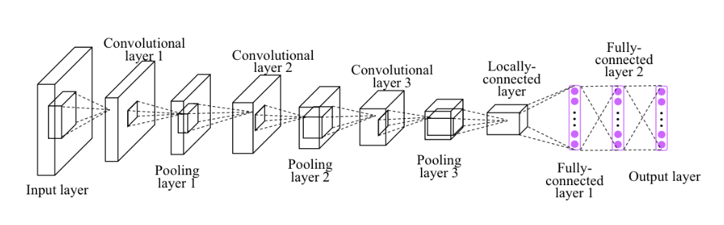
CNN Architecture
1. Convolution layer -Conv2D
2. Pooling layer MaxPooling2D
3. Flatten layer
4. Fully connected layer -Dense

Slide 14
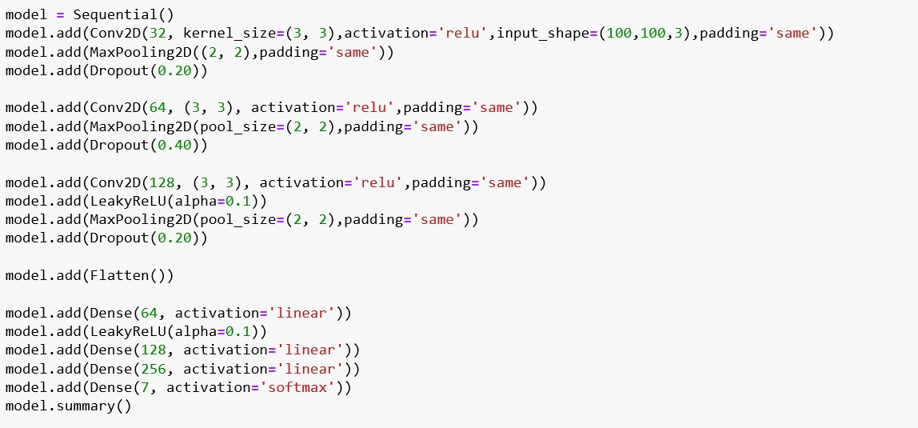
CNN Architecture

Slide 15
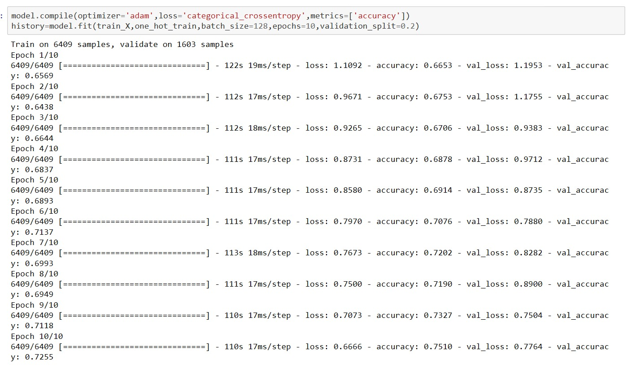
Setting Optimizer and Fitting the model

Slide 16
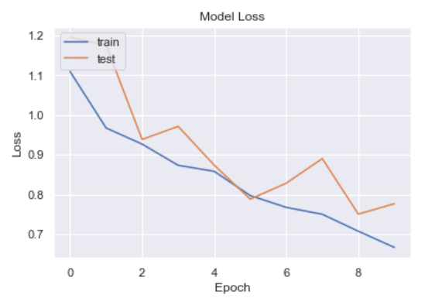
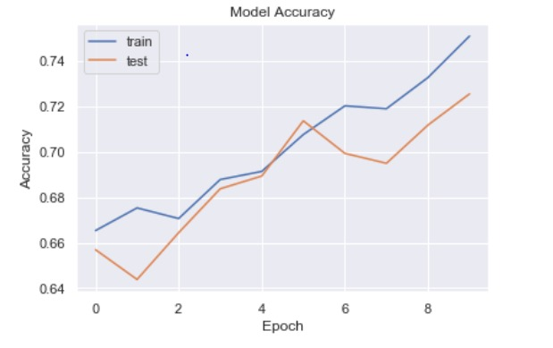
Model Evaluation

Slide 17
Conclusion
Accuracy is higher if model is trained on more samples of lower resolution than small samples of high resolutions.
We have achieved the accuracy of 75%.
Future Scope
Going forward, we can continue to refine the model to achieve a stable decrease in loss function with every epoch, build an interface such that given an image of a skin lesion within the two classes, the output will give a % probability of which of the seven classes it belongs to.

Slide 18
Q & A
Thank You

